Slide 1
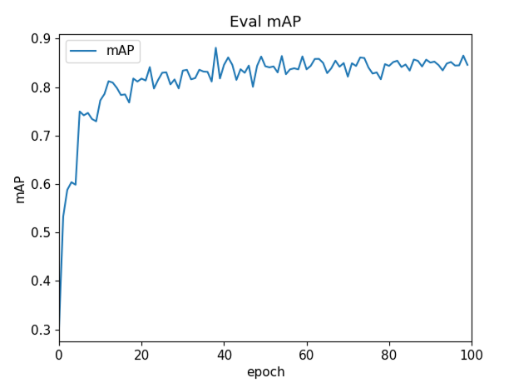



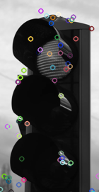
Workflow of SD-CSNN (SURF Descriptor – CNN Siamese Neural Network)
Data preprocessing
Model construction
Performance evaluation
Kaggle Road Sign Detection
Dataset
4 labels of samples
Performance visualization
Speed limit
Crosswalk
Traffic light
Stop sign
4 label types
CNN
Existing method comparison
CNN training
Compare the proposed
method with
existing methods
SURF Feature Extraction using RGB
Filter
Attention Supervised
Siamese network
Performance measurement
Training datasets
Five-Fold cross-validation training enhancing learning
evaluation metrics
Fps
mAP
Model training
701 samples
Parameter saving module
Testing datasets
Parameters are saved in checkpoints after each training process
Performance evaluating module
Performance evaluation
176 samples
Load checkpoints and evaluate
Network architecture of SD-CSNN
Input
CNN + Siamese Network block
FNN
Prediction
Input1
CNN Block
…
…
Probability of stop sign
SURF Feature
Conv1 Conv2 Conv3
Probability of speed limit
Attention Supervised
Shared parameters
Input2
Probability of Traffic light
CNN Block
Probability of Crosswalk
…
…
Loss 1: contrastive loss
Loss 2:
Cross-entropy loss
SURF Feature
Conv1 Conv2 Conv3

